Slide 1
Recursion

Slide 2
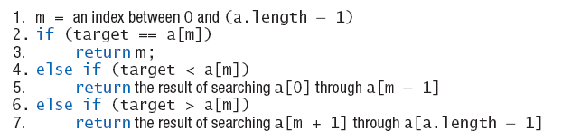
Binary Search
Draft 1 of algorithm
  Algorithm requires additional parameters

Slide 3
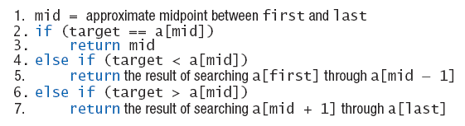
Binary Search
Draft 2 of algorithm to search a[first] through a[last]
  What if target is not in the array?

Slide 4
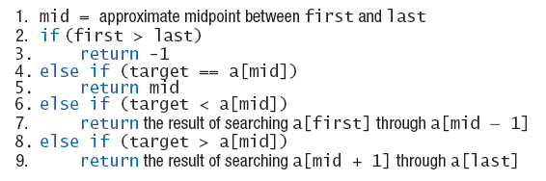
Binary Search
Final draft of algorithm to search a[first] through a[last] to find target

Slide 5
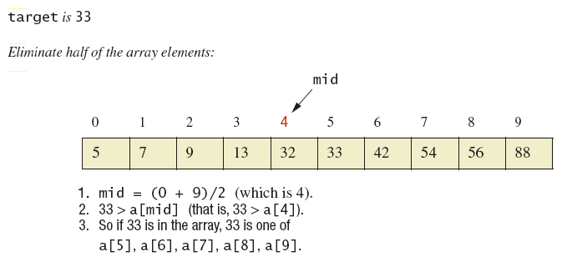
Binary Search
Binary search example

Slide 6
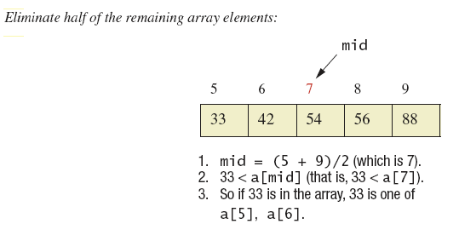
Binary Search
Binary search example

Slide 7
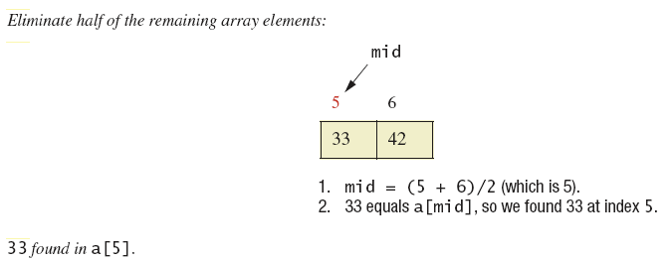
Binary Search
Binary search example

Slide 8
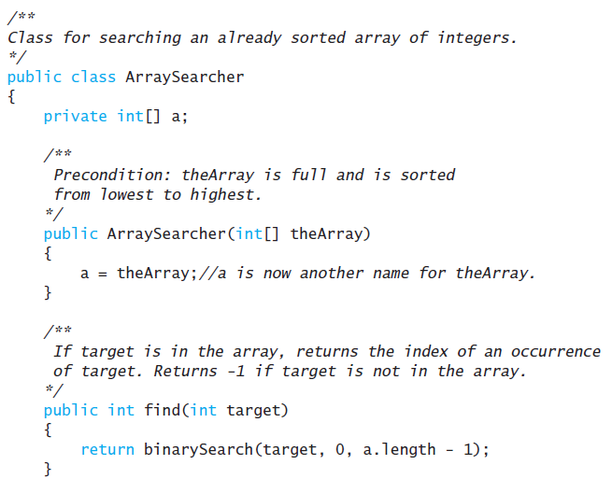
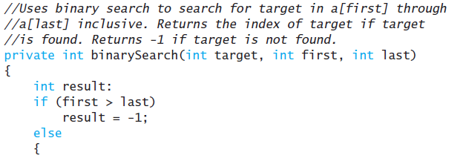
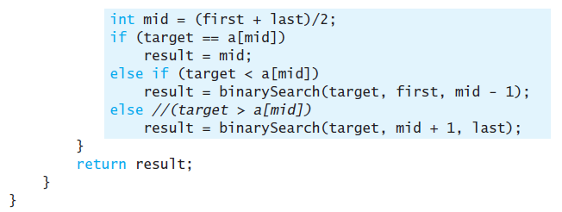
Binary Search

Slide 9
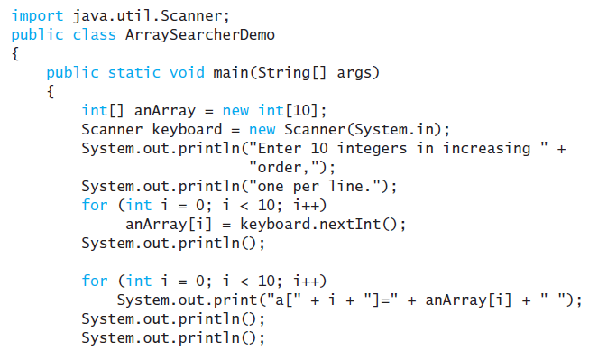
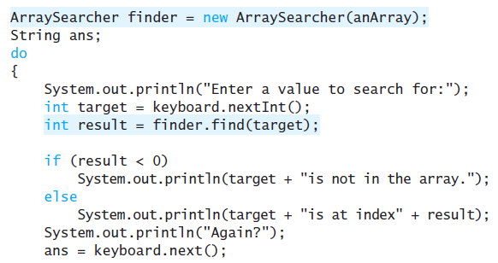
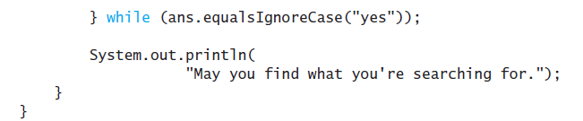
Binary Search

Slide 10
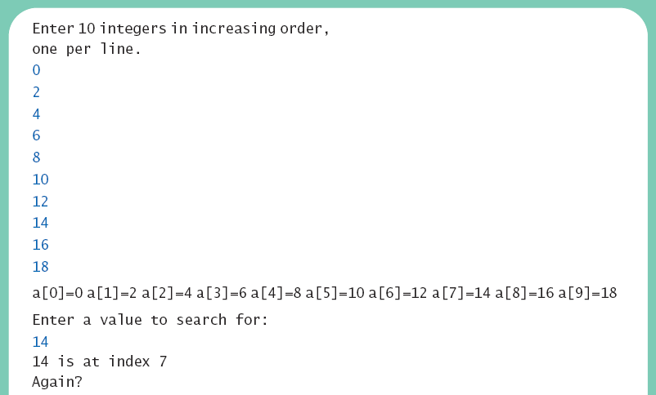
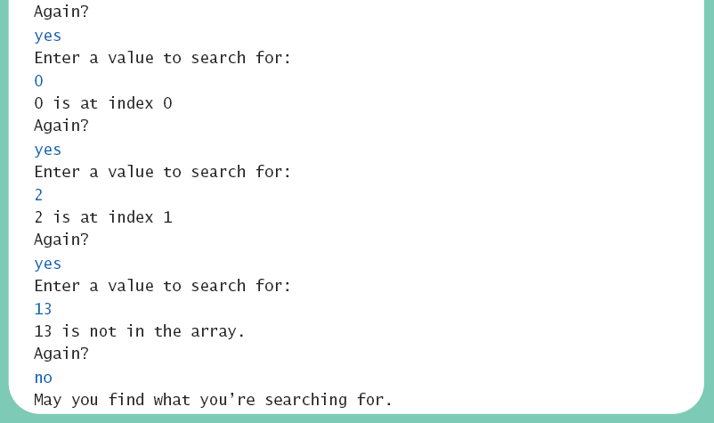
Binary Search
Sample
screen output

Slide 11
Programming Example
Merge sort – A recursive sorting method
A divide-and-conquer algorithm
  Array to be sorted is divided in half
  The two halves are sorted by recursive calls
  This produces two smaller, sorted arrays which are merged to a single sorted array

Slide 12
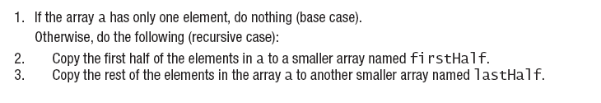

Merge Sort
Algorithm to sort array a

Slide 13
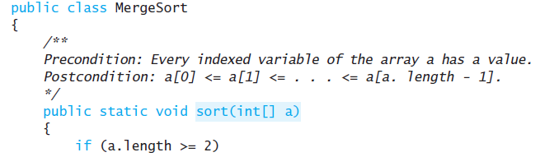
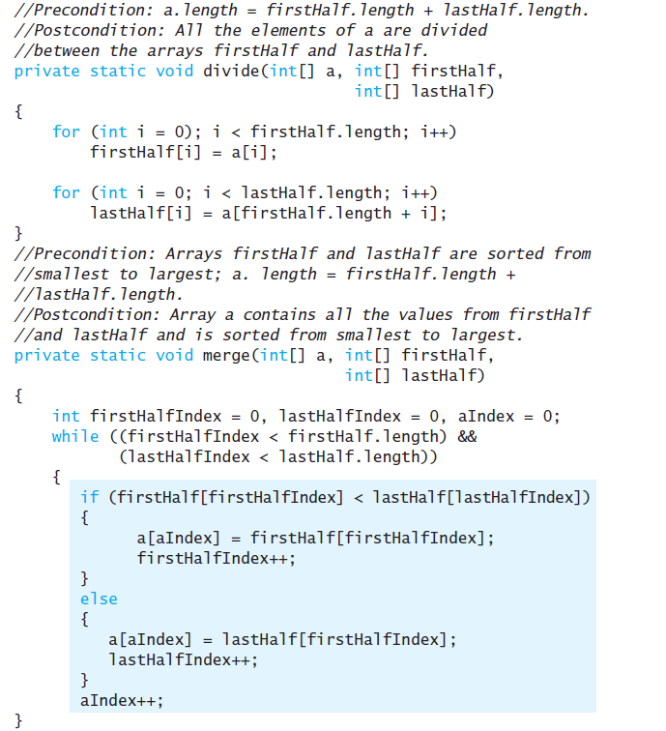
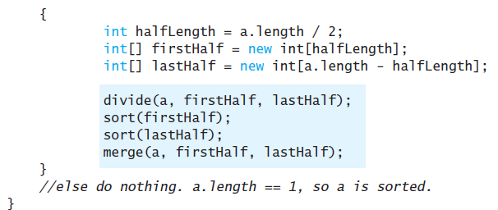
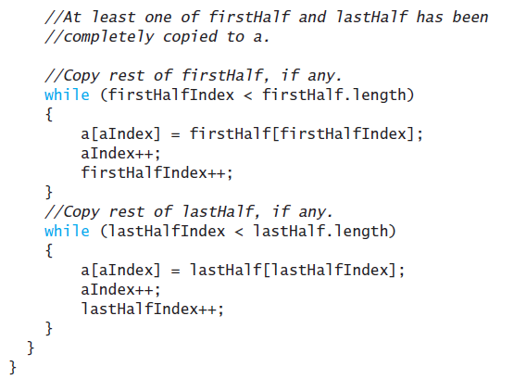

Slide 14
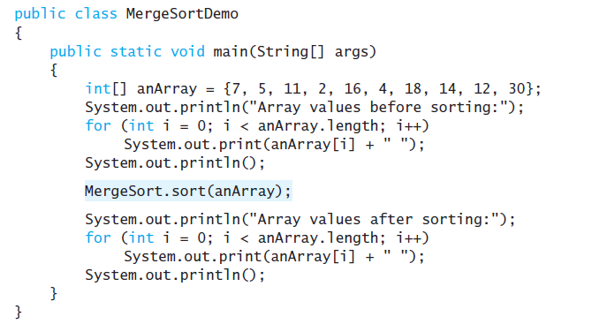
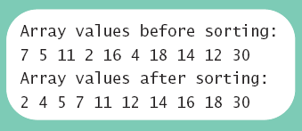
Merge Sort
Sample
screen output

